Slide 1

Don't Just PDF, "Smart" PDF!
Move your PDF to the next level

Slide 2

Don't Just PDF, "Smart" PDF!

Slide 3
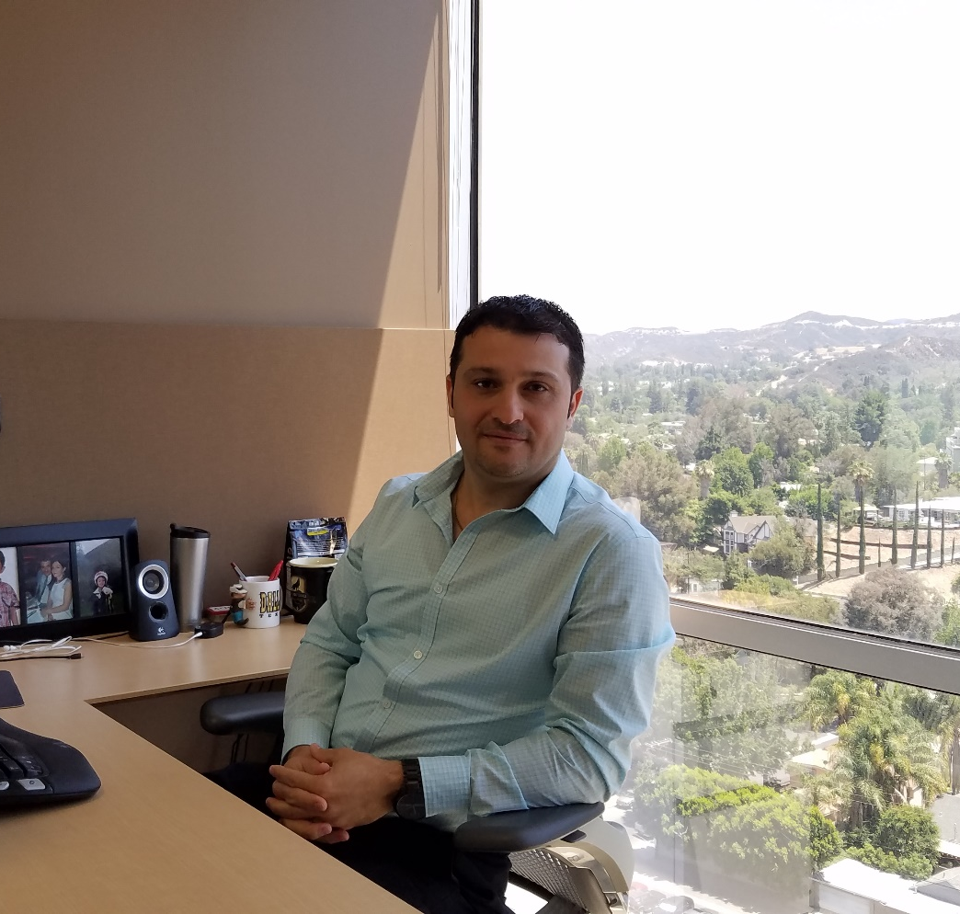
Who am I
Shirak Avakian
Enterprise Solution Architect
QBI LLC
@ShirakAvakian
ShirakAvakian@gmail.com

Slide 4
Who am I
Shirak Avakian
Enterprise Solution Architect
QBI LLC
@ShirakAvakian
ShirakAvakian@gmail.com

Slide 5

Definitions & Facts
What is PDF
Portable Document Format (PDF) is a file format used
to present and exchange documents reliably,
independent of software, hardware, or operating
system.
Some Facts About PDF
Invented by Adobe.
Open standard maintained by the International Organization for
Standardization (ISO).
Can contain links and buttons, form fields,
audio, video, and business logic.
Can also be signed electronically

Slide 6
What is PDF
Portable Document Format (PDF) is a file format used
to present and exchange documents reliably,
independent of software, hardware, or operating
system.
Some Facts About PDF
Invented by Adobe.
Open standard maintained by the International
Organization for Standardization (ISO).
Can contain links and buttons, form fields,
audio, video, and business logic.
Can also be signed electronically

Slide 7
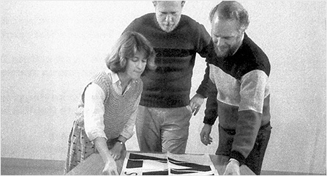
History
In 1991, Adobe cofounder Dr. John Warnock launched the paper-to-digital revolution with an idea he called The Camelot Project.
By 1992, Camelot had developed into PDF. Today, it is the format trusted by businesses around the world.
Today, Warnock's vision is alive, well, and evolving. Adobe PDFs preserve all the data in the original file - even when text, graphics, spreadsheets, and more

Slide 8
History
In 1991, Adobe cofounder Dr. John Warnock launched the paper-to-digital revolution with an idea he called The Camelot Project.
By 1992, Camelot had developed into PDF. Today, it is the format trusted by businesses around the world.
Today, Warnock's vision is alive, well, and evolving. Adobe PDFs preserve all the data in the original file - even when text, graphics, spreadsheets, and more

Slide 9

Security
Password protect your PDF
Redact sensitive information
Sanitization—Remove hidden data from PDF
Digitally sign the PDF using private/public key pair

Slide 10
Security
Password protect your PDF
Redact sensitive information
Sanitization—Remove hidden data from PDF
Digitally sign the PDF using private/public key pair

Slide 11
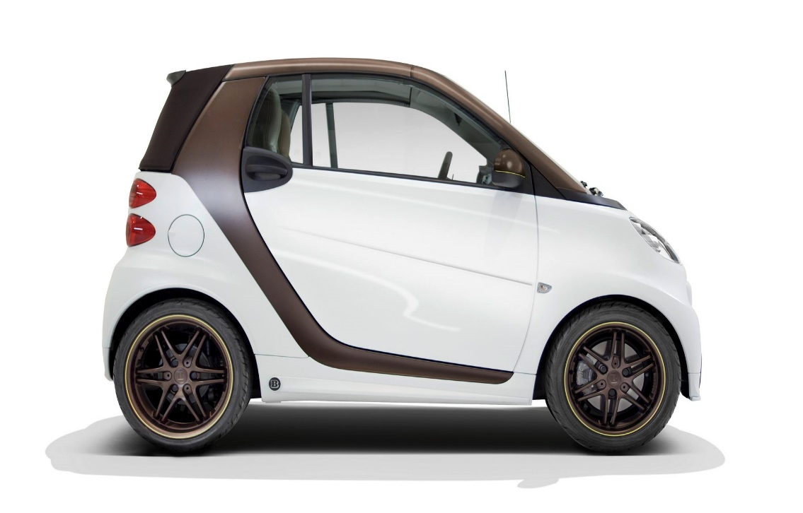

Conclusion
If you can share & reduce physical occupation of 1000 books to 1000 digital files resting in your lap.
If you can search for files, pages within seconds.
If you can sign, edit, comment, stamp PDF.
If you can secure a PDF.
If all above can be done by a PDF, shouldn’t we call it SMART?

Slide 12
Conclusion
If you can share & reduce physical occupation of 1000 books to 1000 digital files resting in your lap.
If you can search for files, pages within seconds.
If you can sign, edit, comment, stamp PDF.
If you can secure a PDF.
If all above can be done by a PDF, shouldn’t we call it SMART?

Slide 13
Not yet, until we make it smarter by predefining the workflow
Custom Properties.
Exporting and importing metadata.
Sanitization.
Barcode.
All together to create PDF workflow.

Slide 14
Not yet, until we make it smarter by
Predefining workflow
Custom Properties.
Exporting and importing metadata.
Sanitization.
Barcode.
All together to create PDF workflow.

Slide 15
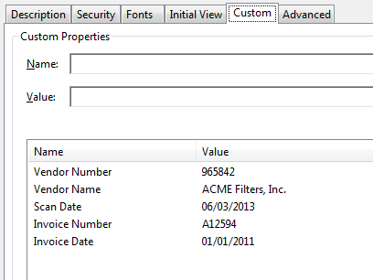
PDF Custom Properties
Ability to add custom properties to store specific data.
ColdFusion can only read custom properties as of 2016 release.
To Create custom properties we will use JAVA.
No need to load extra library ColdFusion already has iText java library pre-loaded.

Slide 16
PDF Custom Properties
Ability to add custom properties to store specific data.
ColdFusion can only read custom properties as of 2016 release.
To Create custom properties we will use JAVA.
No need to load extra library ColdFusion already has iText java library pre-loaded.

Slide 17
DEMO
Demo-CustomProperty

Slide 18
DEMO
Demo-CustomProperty

Slide 19


Exporting & Importing Metadata
Metadata Includes information about the document and its contents, such as the author’s name, keywords, and copyright information, that can be used by search utilities.
XMP The Extensible Metadata Platform (XMP) provides Adobe applications with a common XML framework that standardizes the creation, processing, and interchange of document metadata across publishing workflows.

Slide 20
Exporting and importing metadata
Metadata Includes information about the document and its contents, such as the author’s name, keywords, and copyright information, that can be used by search utilities.
XMP The Extensible Metadata Platform (XMP) provides Adobe applications with a common XML framework that standardizes the creation, processing, and interchange of document metadata across publishing workflows.

Slide 21
Exporting & Importing Metadata
Export Specify the source of the PDF and destination of the XMP file.
<cfpdf action=“export” type=“metadata” source = “file.pdf” exportTo =“file.xmp”/>
Import Specify the source of the PDF, the source of XMP file and the destination for the file to be placed.
<cfpdf action=“import” type=“metadata” source=“file.pdf” importFrom=“file.xmp” destination=“PDF output file pathname” /or name=“PDF document variable name”/>

Slide 22
Exporting and importing metadata
Export Specify the source of the PDF and destination of the XMP file.
<cfpdf action=“export” type=“metadata” source = “file.pdf” exportTo =“file.xmp”/>
Import Specify the source of the PDF, the source of XMP file and the destination for the file to be placed.
<cfpdf action=“import” type=“metadata” source=“file.pdf” importFrom=“file.xmp” destination=“PDF output file pathname” /or name=“PDF document variable name”/>

Slide 23
DEMO
Demo-Export-Import

Slide 24
DEMO

Slide 25
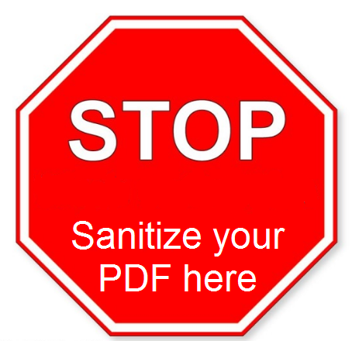
Sanitization
Sanitize Removes metadata from your PDF document so that sensitive information is not inadvertently passed along when you publish your PDF.
Sanitize removes the following:
Metadata
Attached files
Scripts
Search indexes
Form data
Review and comment data
Obscured text and images
Unreferenced data
Links
Actions and javascripts
Overlapping objects

Slide 26
Sanitization
Sanitize Removes metadata from your PDF document so that sensitive information is not inadvertently passed along when you publish your PDF. Sanitize removes the following:
Metadata
Attached files
Scripts
Search indexes
Form data
Review and comment data
Obscured text and images
Unreferenced data
Links
Actions and javascripts
Overlapping objects

Slide 27
DEMO
Demo-Sanitize

Slide 28
DEMO

Slide 29
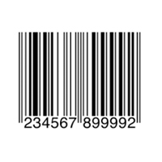
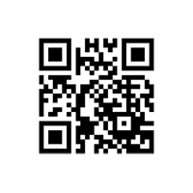
Barcode
A barcode is an optical, machine-readable, representation of data; the data usually describes something about the object that carries the barcode. (Wikipedia)
One-Dimensional (1D) Barcode
Systematically represent data by varying the widths and spacings of parallel lines, and may be referred to as linear or one-dimensional.
Two-Dimensional (2D) Barcode
Systematically represent data using two-dimensional symbols and shapes. They are similar to a linear 1D barcode, but can represent more data per unit area.

Slide 30
Barcode
A barcode is an optical, machine-readable, representation of data; the data usually describes something about the object that carries the barcode. (Wikipedia)
One-Dimensional (1D) Barcode
Systematically represent data by varying the
widths and spacings of parallel lines, and may
be referred to as linear or one-dimensional.
Two-Dimensional (2D) Barcode
Systematically represent data using two-dimensional
symbols and shapes. They are similar to a linear
1D barcode, but can represent more data
per unit area.

Slide 31

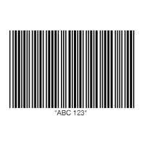

Barcode-1D Types
One-Dimensional (1D) Barcode Types
UPC CODE
EAN CODE
CODE 39
CODE 128
ITF (Interleaved 2 OF 5)
CODE 93
CODABAR
GS1 DATABAR
MSI PLESSEY
UPC CODE
ITF (Interleaved 2 OF 5)
CODE 39
MSI PLESSEY

Slide 32
Barcode
One-Dimensional (1D) Barcode Types
UPC CODE
EAN CODE
CODE 39
CODE 128
ITF (Interleaved 2 OF 5)
CODE 93
CODABAR
GS1 DATABAR
MSI PLESSEY
UPC CODE
ITF (Interleaved 2 OF 5)
CODE 39
MSI PLESSEY

Slide 33

Barcode-2D Types
Two-Dimensional (2D) Barcode
QR Code
Used in tracking and marketing. Free to use, flexible in size, have a high fault tolerance, and have fast readability, though they can’t be read with a laser scanner. Support four different modes of data: numeric, alphanumeric, byte/binary, and Kanji. They are public domain and free to use.
PDF417
Used in applications that require the storage of huge amounts of data, such as photographs, fingerprints, signatures, text, numbers, and graphics.
They can hold over 1.1 kilobytes of machine-readable data, making them much more powerful than other 2D barcodes. Like QR codes, PDF417 barcodes are public domain and free to use.
DATAMATRIX CODE
AZTEC

Slide 34
Barcode
Two-Dimensional (2D) Barcode
QR Code
Used in tracking and marketing. Free to use, flexible in size, have a high fault tolerance, and have fast readability, though they can’t be read with a laser scanner. Support four different modes of data: numeric, alphanumeric, byte/binary, and Kanji. They are public domain and free to use.
PDF417
Used in applications that require the storage of huge amounts of data,
such as photographs, fingerprints, signatures, text, numbers, and graphics.
They can hold over 1.1 kilobytes of machine-readable data, making them
much more powerful than other 2D barcodes. Like QR codes, PDF417
barcodes are public domain and free to use.
DATAMATRIX CODE
AZTEC

Slide 35
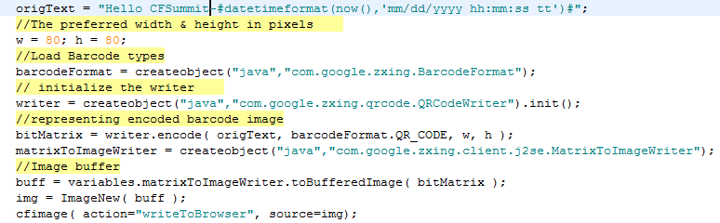
Barcode-2D-QR
How to generate/read QR Barcode
Download ZXing ("zebra crossing") is an open-source, multi-format 1D/2D barcode image processing library implemented in Java. https://github.com/zxing/zxing
Save the library in your ColdFusion class path C:\{cfserverhome}\{cfusion}\wwwroot\WEB-INF\lib
Restart ColdFusion server

Slide 36
Barcode
Two-Dimensional (2D) Barcode
How to generate/read QR Barcode
Download ZXing ("zebra crossing") is an open-source, multi-format 1D/2D barcode image processing library implemented in Java. https://github.com/zxing/zxing
Save the library in your ColdFusion class path C:\{cfserverhome}\{cfusion}\wwwroot\WEB-INF\lib
Restart ColdFusion server

Slide 37
DEMO
Demo-Barcode

Slide 38
DEMO

Slide 39
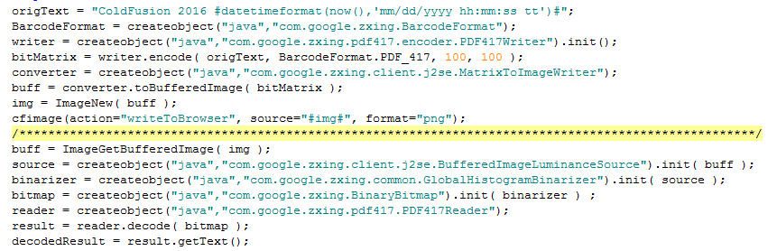
Barcode-2D-PDF417
How to generate PDF417 Barcode

Slide 40
Barcode
Two-Dimensional (2D) Barcode
How to generate PDF417 Barcode

Slide 41
DEMO
Demo-Barcode

Slide 42
DEMO

Slide 43
All together in real case scenario
Projected subject
Custom properties
Export XMP
barcode
sanitize
send
receive
Read barcode
Import XMP
Continue next action
Managing the LiveCycle of a PDF starting from creating to final signature and storage.
Combining previously discussed actions we can track and manage a PDF.
Electronically received PDFs are much easier to manage than mailed in PDFs

Slide 44
Putting All together in real case scenario
Projected subject
Custom properties
Export XMP
barcode
sanitize
send
receive
Read barcode
Import XMP
Continue next action
Managing the LiveCycle of a PDF starting from creating to final signature and storage.
Combining previously discussed actions we can track and manage a PDF.
Electronically received PDFs are much easier to manage than mailed in PDFs

Slide 45
All together in real case scenario
Custom Properties
Export XMP (The Metadata)
Export the metadata (XMP) file to folder structure by making the file name same as tracking number
D:\DMS\xmp\{trackingNumber}.xmp
Create separate drive for your filing system and make sure to tighten your security by only allowing CF account to manage the drive
Run schedule jobs to follow up with file statuses and disk space
Use threads when processing PDFs
Key pair value( TrackingNumber, WorkflowID)
TrackingNumber: unique ID (CreateUUID) to validate the PDF by embedding inside the barcode.
WorkflowID: unique ID (Database ID)definition to tell the PDF what to do next

Slide 46
Putting All together in real case scenario
Custom Properties
Export XMP (The Metadata)
Key pair value( TrackingNumber, WorkflowID)
TrackingNumber: unique ID (CreateUUID) to validate the PDF by embedding inside the barcode.
WorkflowID: unique ID (Database ID)definition to tell the PDF what to do next
Export the metadata (XMP) file to folder structure by making the file name same as tracking number
D:\DMS\xmp\{trackingNumber}.xmp
Create separate drive for your filing system and make sure to tighten your security by only allowing CF account to manage the drive
Run schedule jobs to follow up with file statuses and disk space
Use threads when processing PDFs

Slide 47
DEMO
Demo-Barcode

Slide 48
Thank You
Questions?
Resources?

Slide 49
DEMO

